Slide 1
Lotto

Slide 2
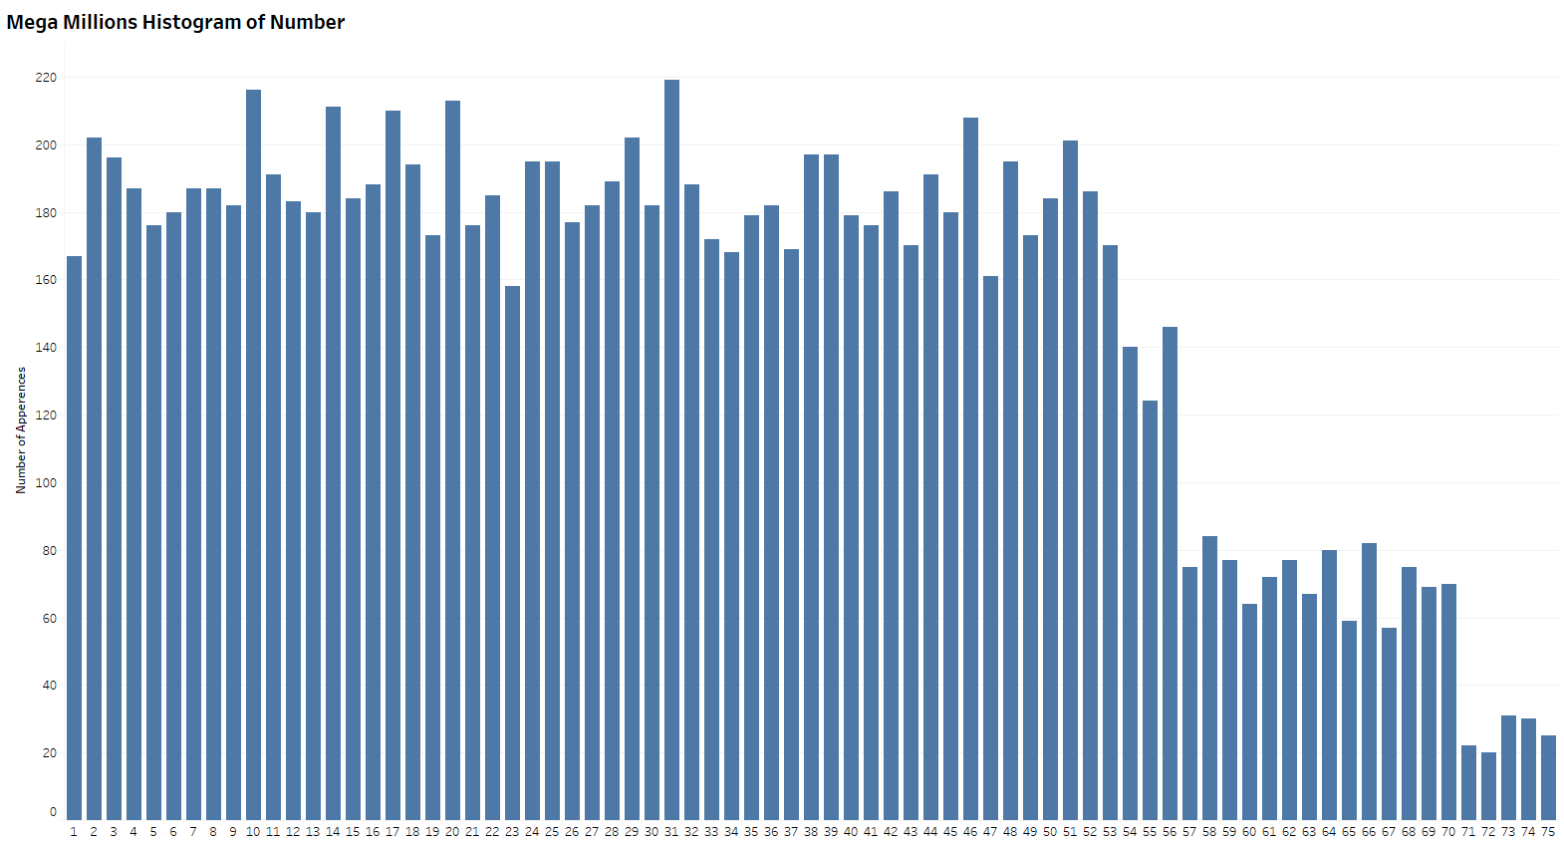
Mega Millions​
Numbers 1-52 are mostly uniformly distributed
The number of potential numbers has increased over time causing these new numbers to show a lower occurrence.

Slide 3
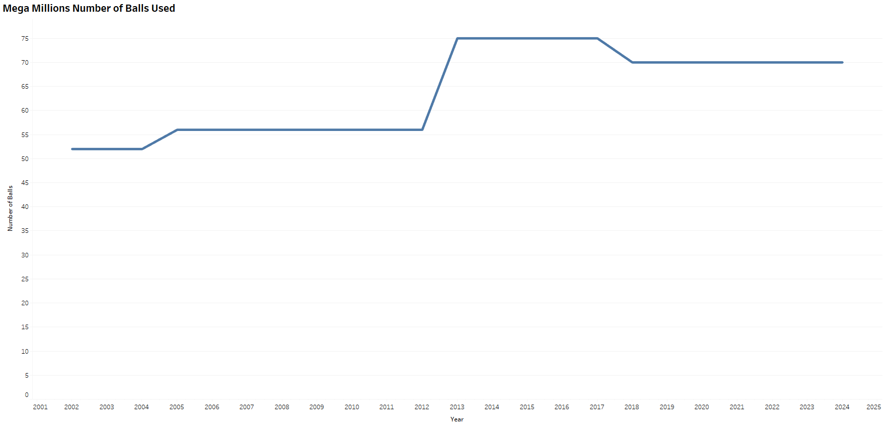
Mega Millions​
The number of balls increased in 2005 and 2013 to a max of 55 and 75 respectively
In 2018 the number of balls was dropped to 70

Slide 4
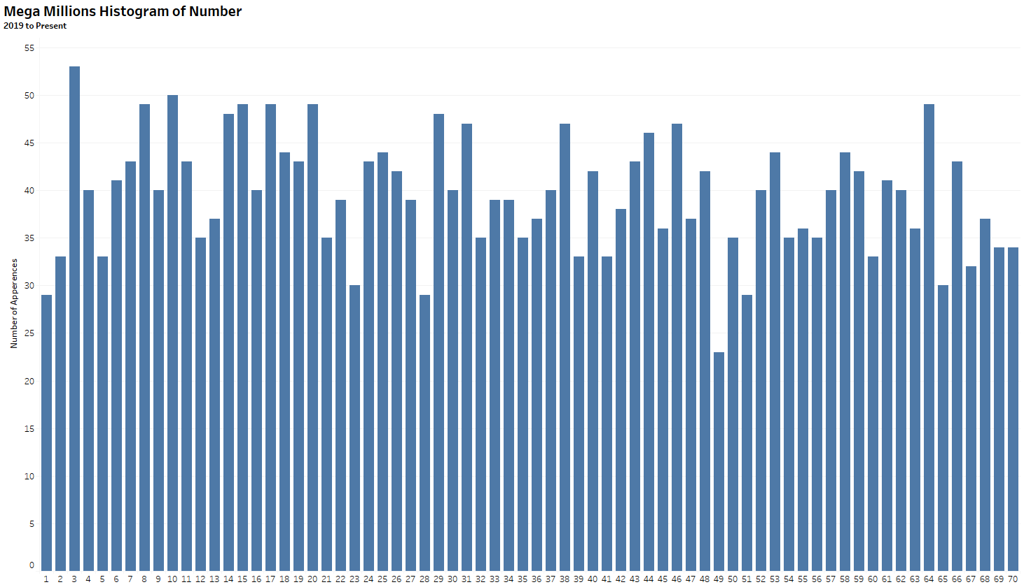
Mega Millions​
Since 2019 the number 49 has not shown up as frequently as the rest.
Please investigate if there is a problem with the ball and replace it if out of spec.

Slide 5
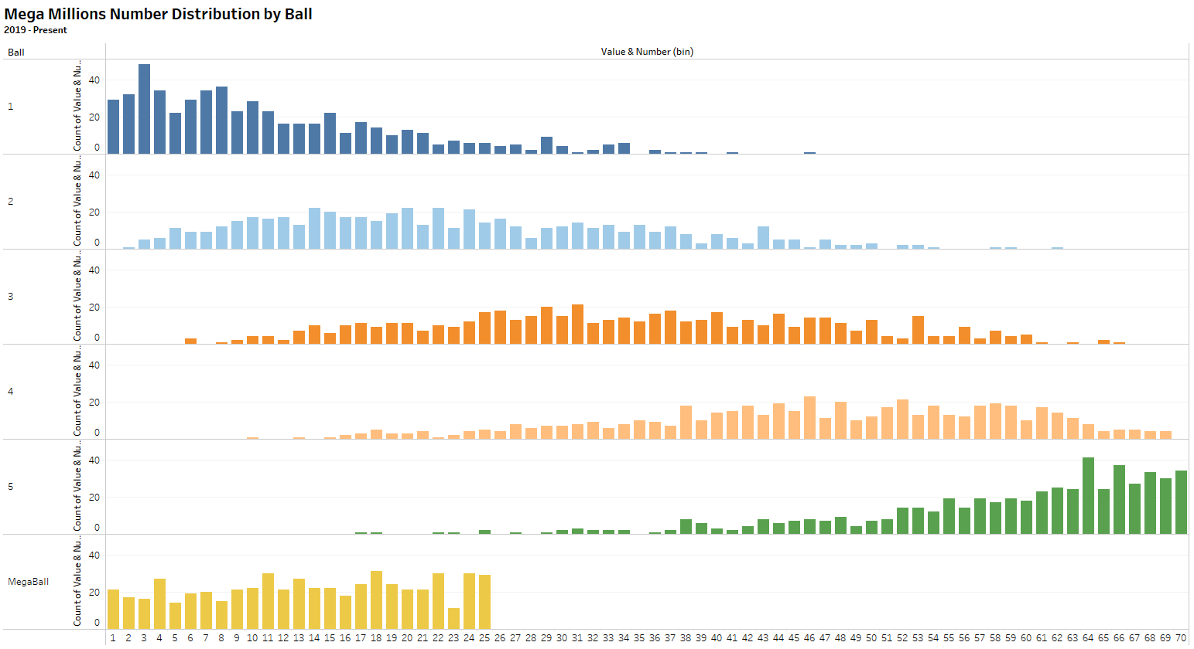
Mega Millions​
The individual ball distributions are as expected

Slide 6
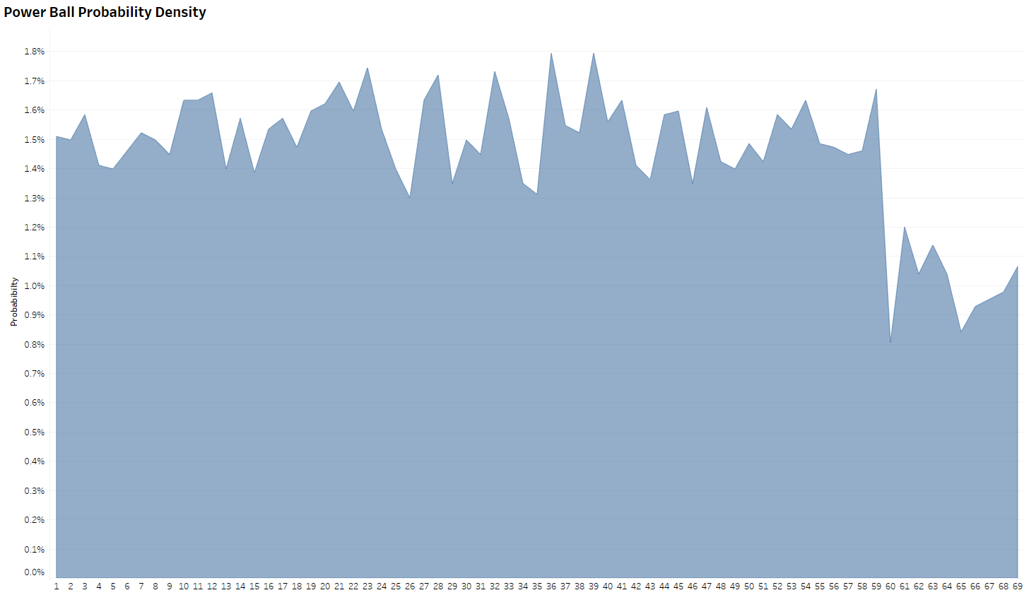
Power Ball​
The probability of each number appearing up to 59 is fairly steady
60 to 69 were added later to they overall have a lower chance to show up.

Slide 7
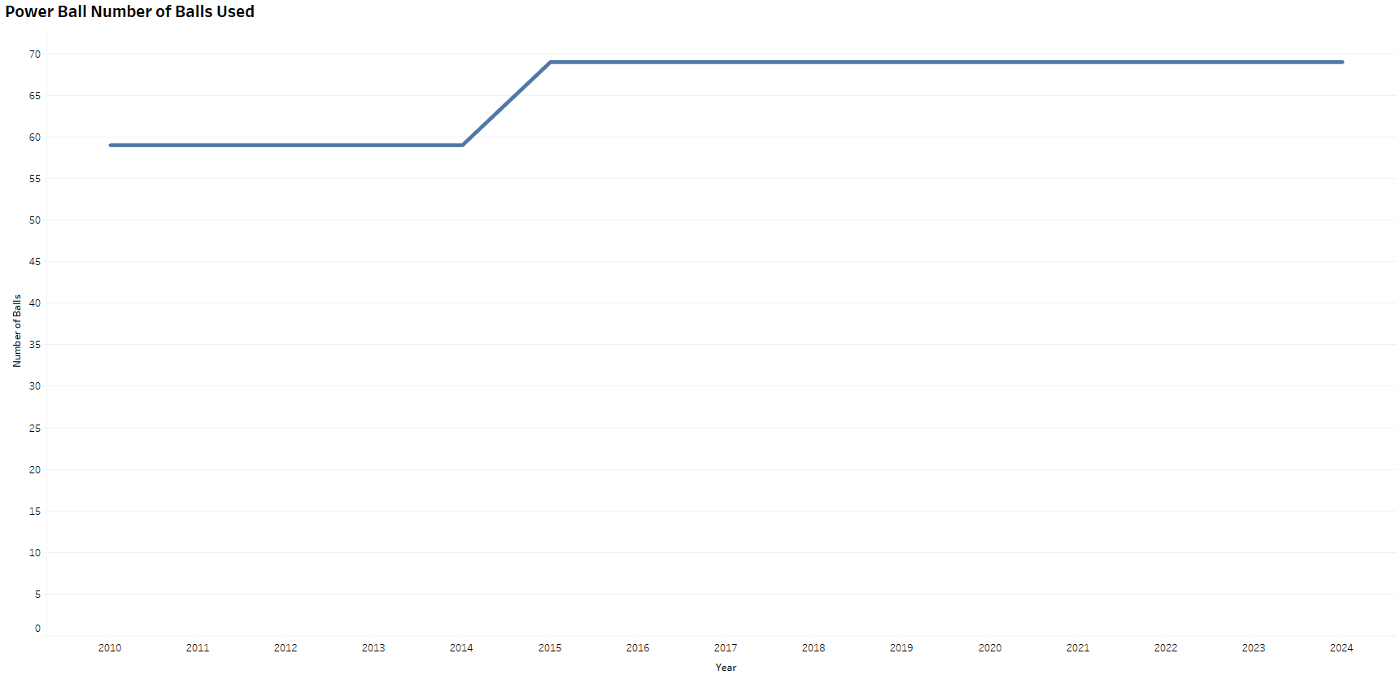
Power Ball​
The number of balls was increased to 69 in 2015

Slide 8
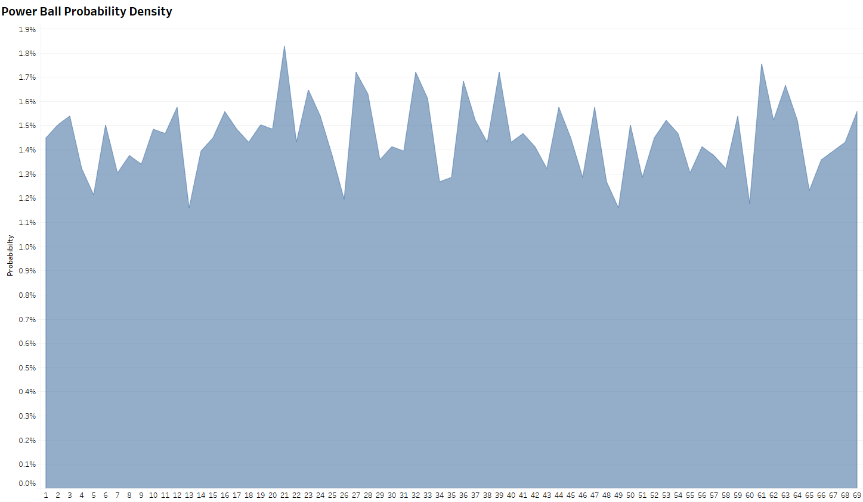
Power Ball​
Looking at the probability after 2015 each ball looks uniformly distributed

Slide 9
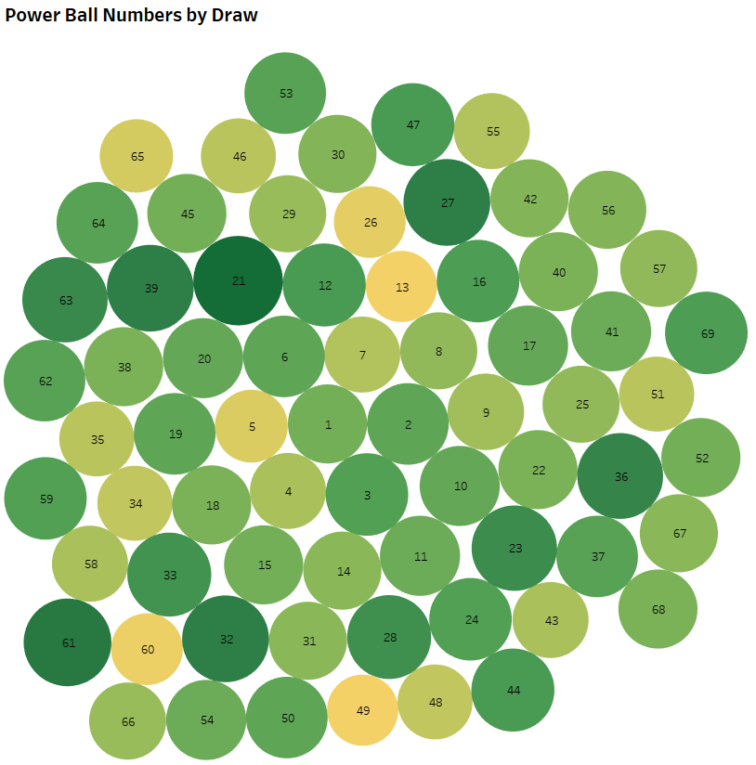

Power Ball​
Since 2015 each ball has been drawn between 64 and 101 times
16, 49, and 60 have the lowest number of times apearing

Slide 10
Power Ball​
Looking at the probability after 2015 each ball looks uniformly distributed

Slide 11
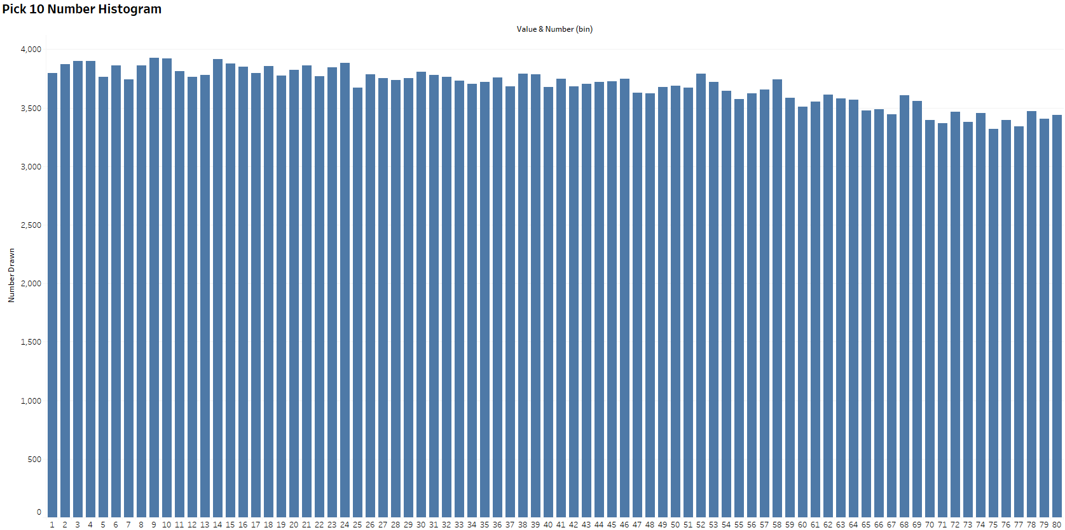
PICK 10​
Pick10 has had a constant ball count
There is a slight under representation in the higher numbers (65 to 80)
Please investigate these balls and see if they need to be replaced.

